Slide 1
Business Analysis on Cocktail Bars
Tongyue Jia, Xiaowei Zhu, Yijin Guan

Slide 2
Background
Goals
In order to achieve commercial success, the owners of bars desperately needed some ways to improve the rating of their bars and attract more customers. We use the relevant data from Yelp to analyze and summarize some business insights and suggestions.
Find out what features can contribute to a successful cocktail bar.
Based on the characteristics of different bars, conduct targeted analysis and provide specific recommendations for businesses.

Slide 3
Workflow
Finished:
To Do:
Data Pre-Processing
Conclude findings and insights
Exploratory Data Analysis
Data-Driven Business Plan
Shiny App
Attribute and Review Analysis

Slide 4
Data Structure
Business
Review
User
Tips
Covid
business_id | attributes | categories | is_open | stars | review_count | ...
review_id | business_id | user_id | stars | useful | funny | cool | text
user_id | review_count | start&elite | useful | funny | cool | fans | friends
user_id | business_id | text
business_id | highlights | Deliver or take out | ...

Slide 5
Data Cleaning
File Name | # Rows | Cleaned # Rows
Business | 160,585 | 1,338
Review | 8,635,403 | 328,552
Tip | 1,162,119 | 36,535
User | 2,189,457 | 220,269
Covid | 209,795

Slide 6
Text Cleaning
Example:
Remove Punctuation
Convert to lower case
Tokenization
Remove non-English words
Remove Stop words
Lemmatization
This is the best place specially during summer evenings . They do provide outer dining area , which is really beautiful . Staff is very friendly .food and drinks are good'
best place specially summer provide outer dining area really beautiful staff friendly food good

Slide 7
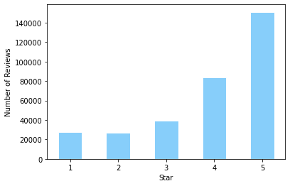
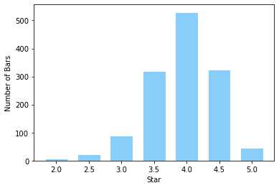
Star Rating of Cocktail Bars
The Distribution of Reviews
The Distribution of Cocktail Bars

Slide 8
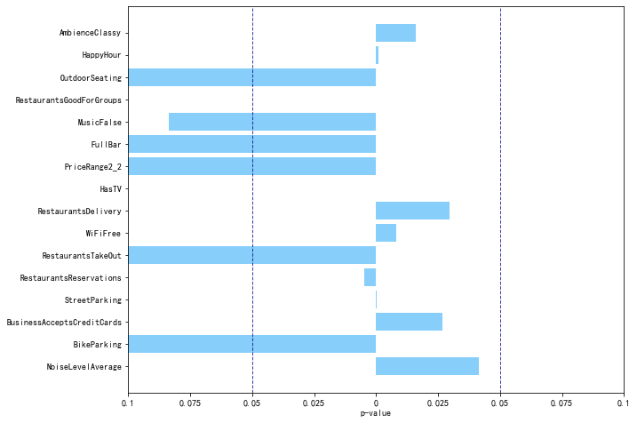
Attributes Analysis --Generalized Linear Regression
Plot of p-value

Slide 9
Attributes Analysis - ANOVA
Goal: To find out the attributes contributing to a successful cocktail bar.
Method: We apply ANOVA on music related attributes, ambience related attributes, parking related attributes and other attributes separately. After we find the influential attributes, we apply multiple comparison to find out further business advice.
Result: Noise level, ambience, music, TV, outdoor seating and on street parking are influential to the cocktail bar business.

Slide 10
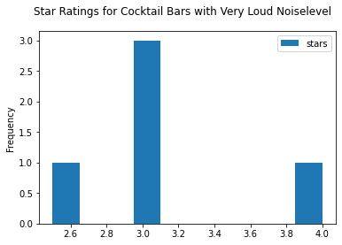
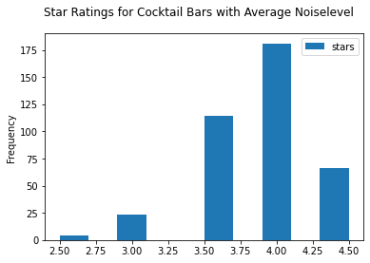
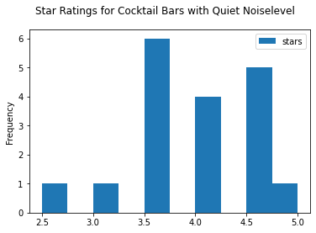
Attributes Analysis - Noise Level
Cocktail bars with average or quiet noise levels have higher star ratings than those with very loud noise.

Slide 11
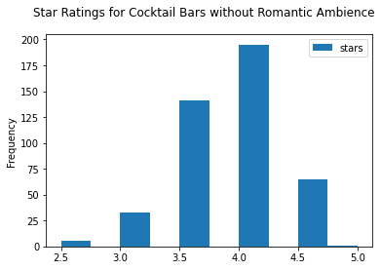
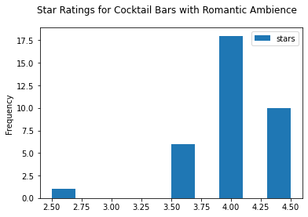
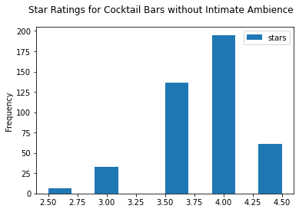
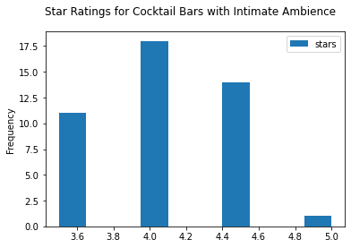
Attributes Analysis - Ambience
Cocktail bars with romantic or intimate ambience have higher star ratings than those without such ambience.
It may contribute to preference in quiet environment.

Slide 12
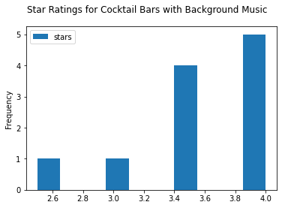

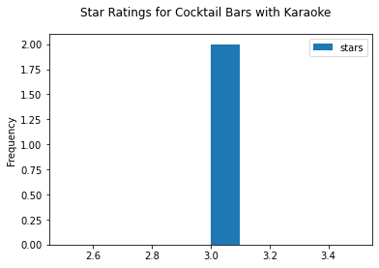
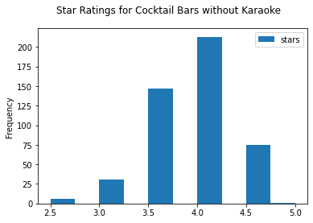
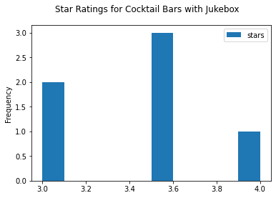

Attributes Analysis - Music
Cocktail bars providing loud music like karaoke or jukebox, or just background music, have lower star ratings.
Dislike in loud music may be related to preference in intimate ambience and quiet environment.

Slide 13
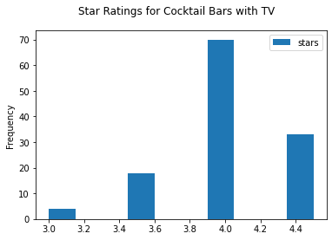
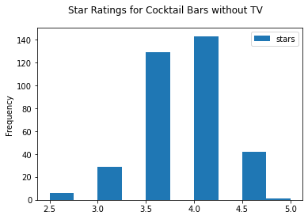
Attributes Analysis - Has TV
Bars with TV tend to have lower star ratings.
It may be related to preference in quiet environment.

Slide 14
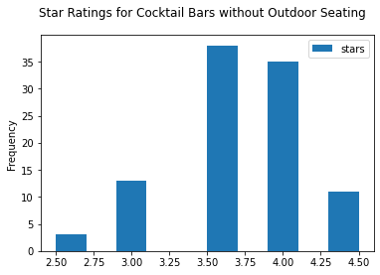
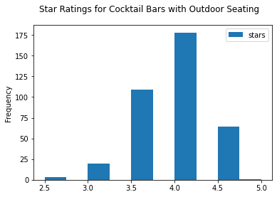
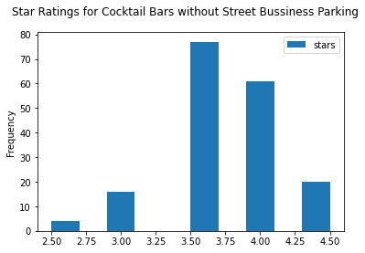
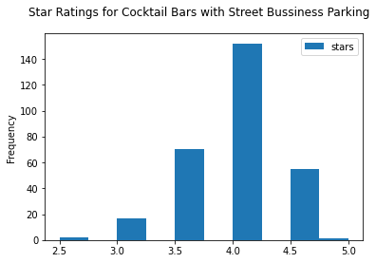
Attributes Analysis - Outdoor Seating, Business Parking
Cocktail bars with outdoor seating and business parking have higher star ratings.
Convenience is also a major consideration for consumers.

Slide 15
Attributes Analysis - Preliminary Conclusion
We have some preliminary conclusions for the cocktail bar owners:
Consumers prefer cocktail bars with romantic and intimate ambience.
People prefer quiet environment in a cocktail bar, and it may be resulted from the conclusion above.
To provide a quiet place, owners should avoid facilities making too much noises, like jukebox, karaoke and TV.
Convenience is also a major consideration for consumers. Owners should mark out convenience features like on street parking and so on.

Slide 16
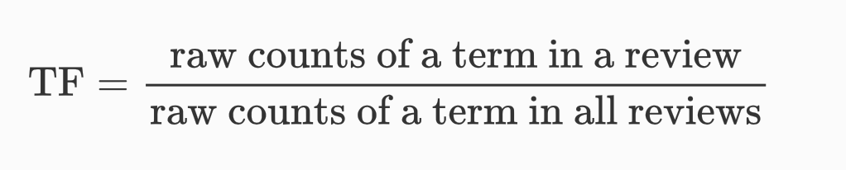
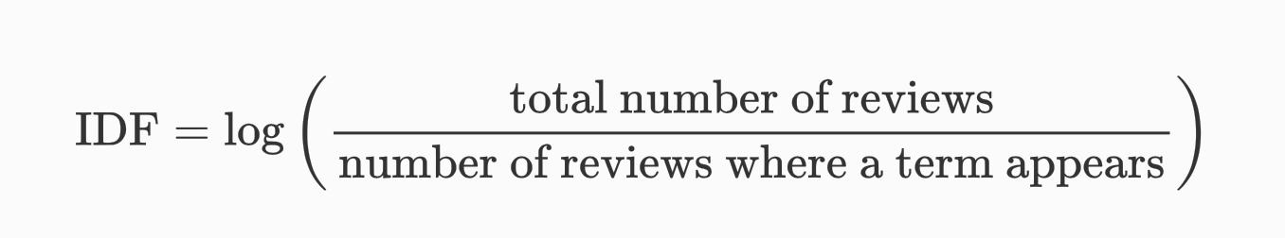
Review Analysis - TF-IDF
We use TF-IDF to compute the occurrence of the words across cocktail bar reviews. The TF-IDF value increases proportionally to the number of a word appears in a review (TF) and is offset by the number of reviews containing the word (IDF).
We make a table summarizing the result of TF-IDF for cocktail bar reviews and divide the words into four parts: Service, Food/Drink, Atmosphere and decoration.

Slide 17
Review Analysis - Frequency words based on TF-IDF
Service | Food/Drink |  | Atmosphere | Decoration
Time | Chicken | Beer | Light | Seat
Staff | Cheese | Wine | Music | Counter
Bartender | Salad | Cocktail | Noisy | Floor
Waitress | Steak | Spirits | Temperature | Toilet
Table | Delicious | Cheap | Live | Clean

Slide 18
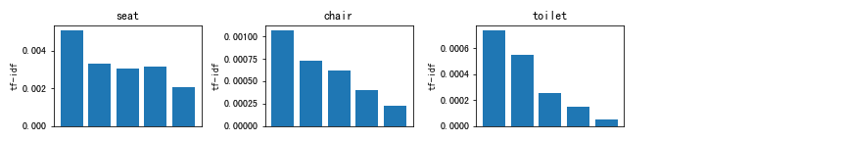
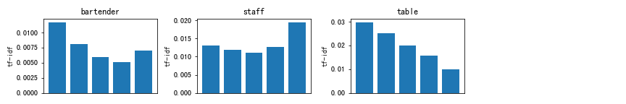
Review Analysis - Words Distribution
Decoration
Service

Slide 19
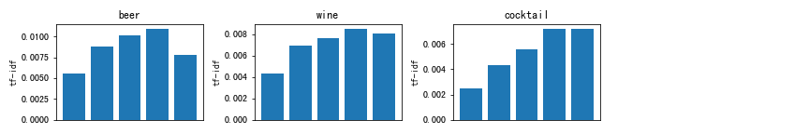
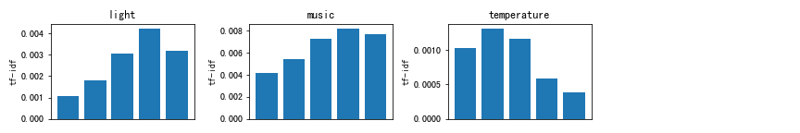
Review Analysis - Words Distribution
Drink
Atmosphere

Slide 20
Review Analysis - Preliminary Conclusion
Chairs should be comfortable, toilets should be clean and constantly monitored.
Provide friendly, efficient table service.
Bartenders should be professional.
Pay attention to the music, lights and temperature in the bar.

Slide 21
Future Plan
Use more powerful methods and models to make personalized recommendations for specific cocktail bars.
Probably make use of covid, tip and user files.
Build a user-friendly shiny app.

